Slide 1



Retail Inventory Demand Forecast Using Hadoop and Spark
23DEA3303R – Big Data Technologies
Team No. 17:
2320030313 – Chandra Teja P
2320030476 – Sriram N
2320030362 – Bharath M

Slide 2
Outline
01
02
Comments Addressed
UML Diagram
03
04
Module-wise Implementation
Comparison and Result
05
06
Conclusion
Future Direction

Slide 3
Comments Addressed
The following improvements were incorporated:
1. UML Diagram
A UML Activity Diagram was introduced to visually represent the system workflow, including data processing, model training, and prediction stages.

Slide 4
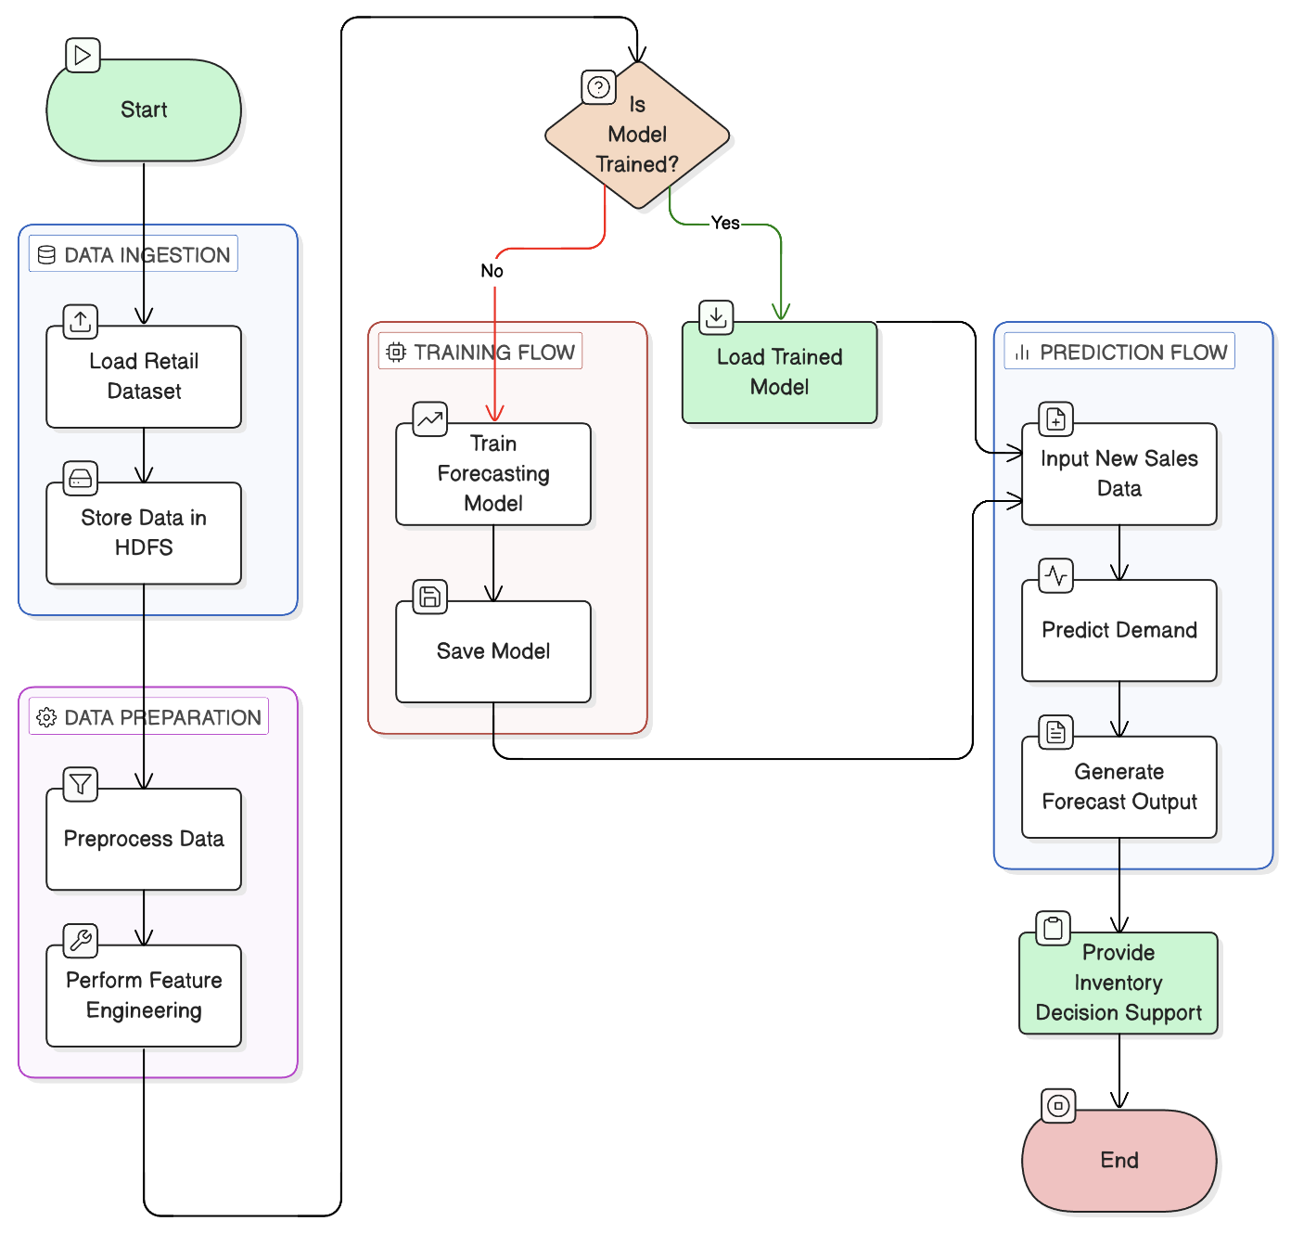

UML
Diagram

Slide 5
Module-wise Implementation

Slide 6
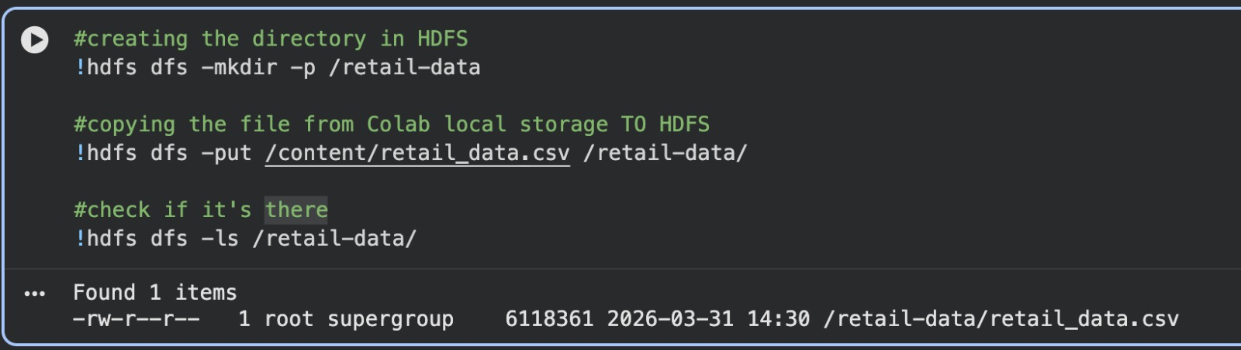
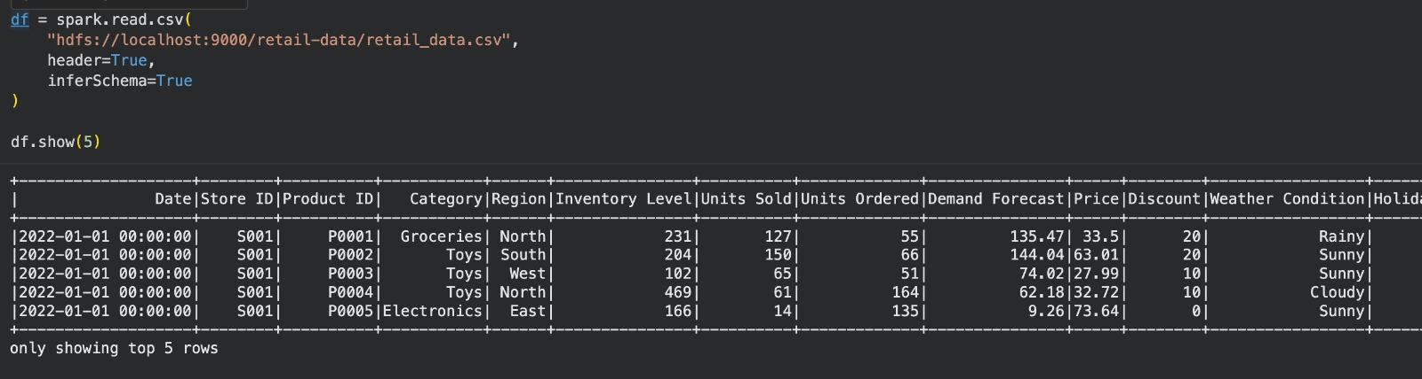
Data Collection & Storage Module

Slide 7
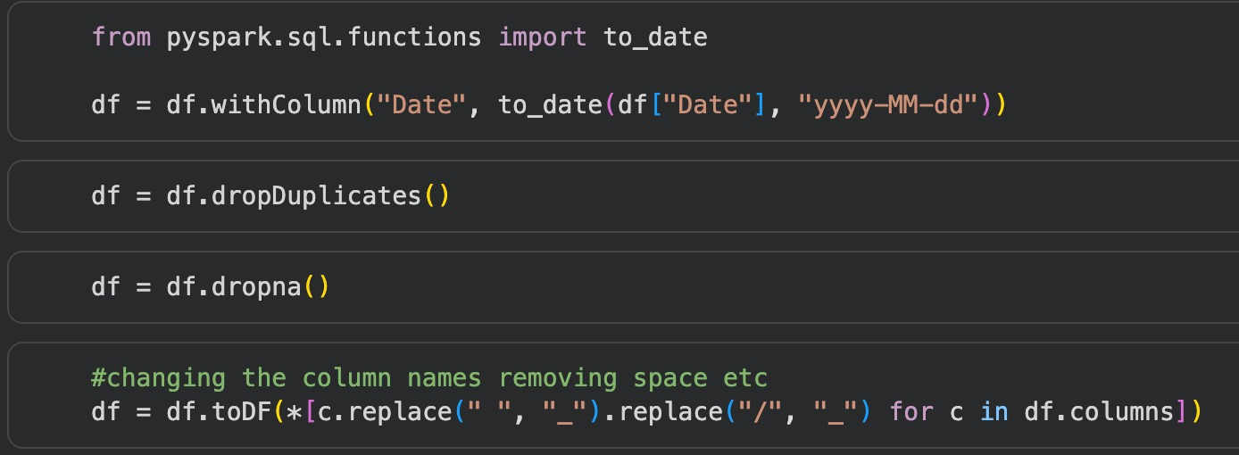
Data Preprocessing Module

Slide 8
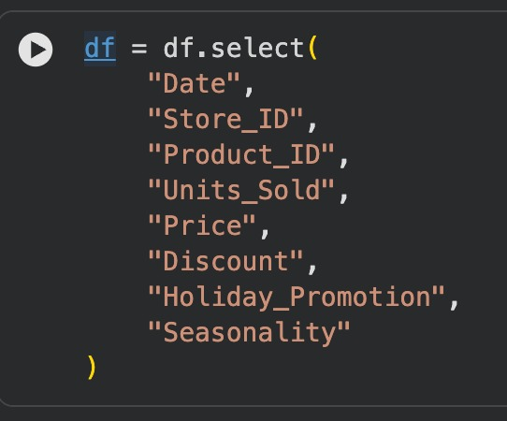
Feature Selection Module

Slide 9
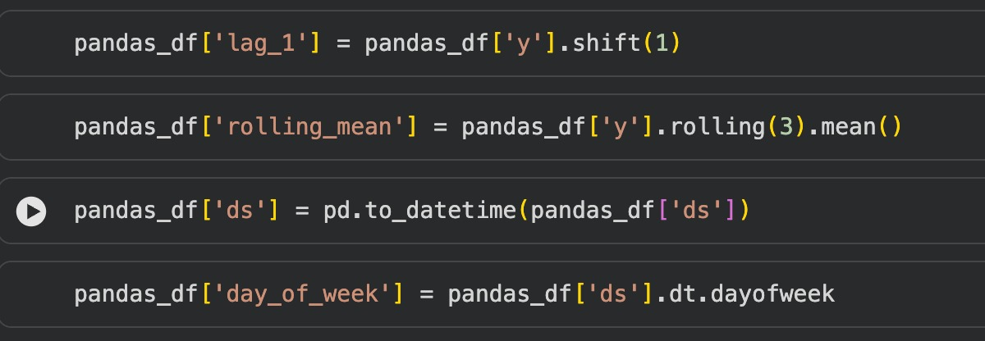
Feature Engineering Module
Notes:
"Lag features capture temporal dependency by using previous demand values to predict future demand.”
"Rolling features help in capturing short-term trends and reducing noise in demand data.”
"Date-based features capture seasonal patterns such as weekly and monthly variations in demand.”
"Feature engineering improves model performance by incorporating temporal dependencies, trends, and seasonal patterns into the dataset.”

Slide 10
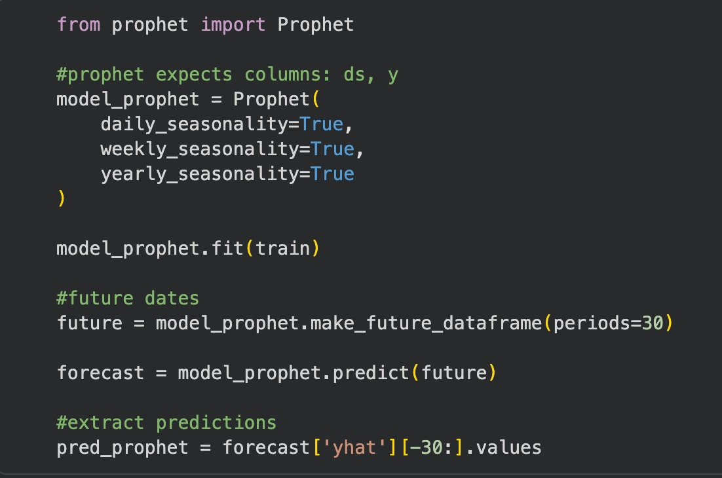
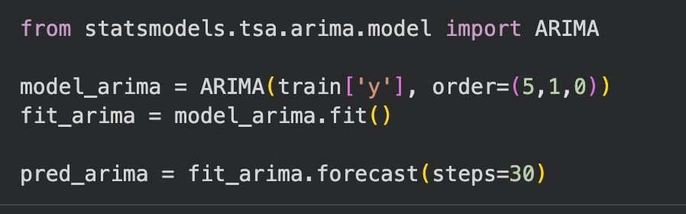
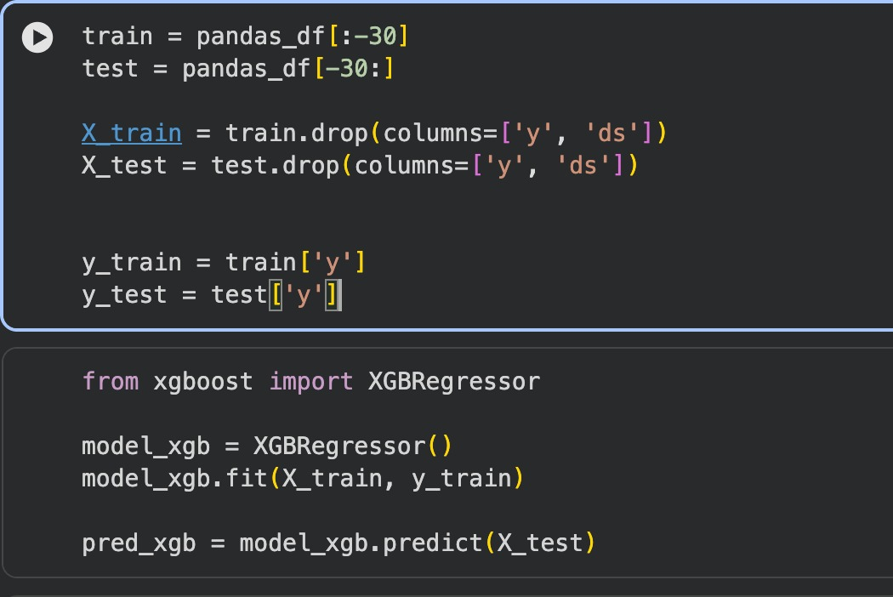
Demand Forecasting Module

Slide 11
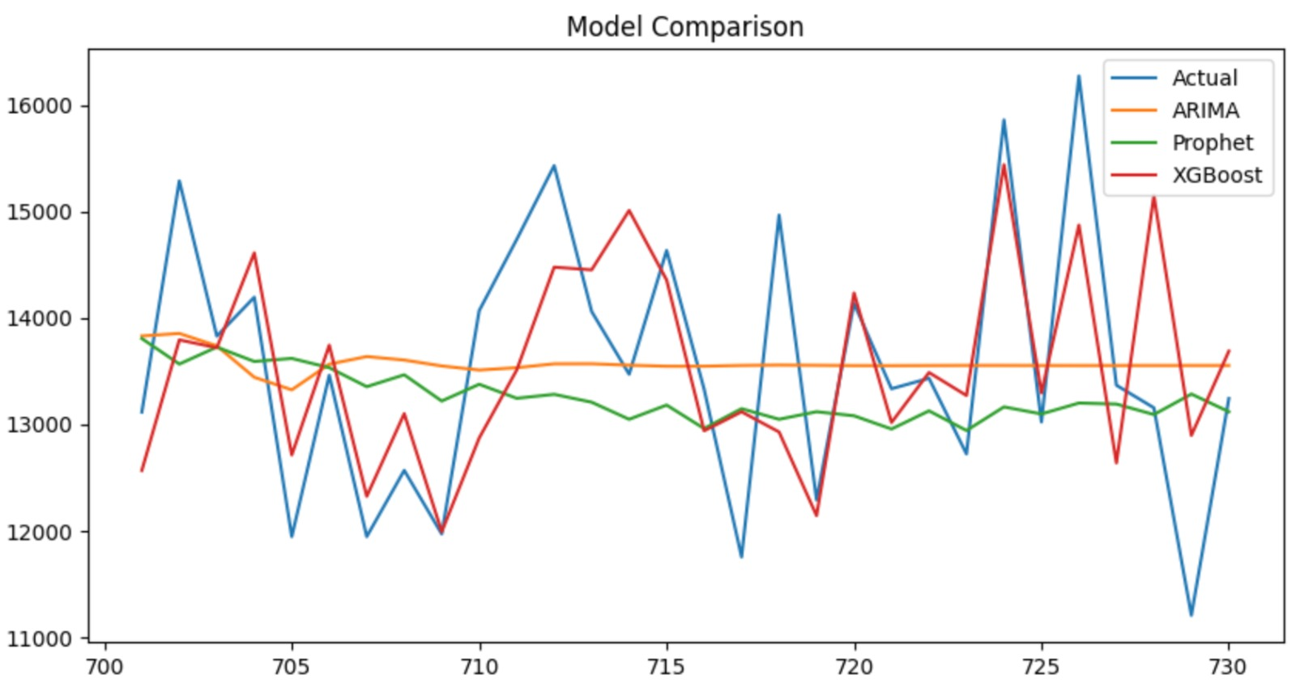
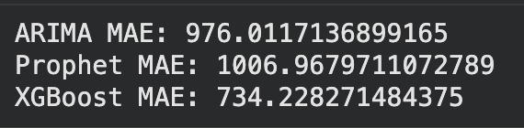
Comparison and Result
Aspect | Our Approach | Model from Research Paper
Complexity | Low–Moderate | High
Training Cost | Low | High
Accuracy | Good (XGBoost best) | Higher potential
Practical Use | Easy deployment and scale | Harder to deploy and maintain
Model | MAE | Relative Error (vs. 13.6k) | Accuracy
XGBoost | 734 | ~5.3% | ~94.7%
ARIMA | 976 | ~7.1% | ~92.9%
Prophet | 1006 | ~7.3% | ~92.7%

Slide 12
Conclusion
Developed a scalable retail demand forecasting system using Hadoop and Spark
Applied time series forecasting to predict future product demand
Improved inventory decision-making using data-driven insights
Reduced risks of overstocking and understocking
Demonstrated the effectiveness of big data technologies in retail analytics

Slide 13
Future Direction
Integrate real-time data processing using streaming frameworks (e.g., Spark Streaming, Kafka)
Incorporate advanced models like LSTM and deep learning for improved forecasting accuracy
Include external factors such as economic indicators and customer behavior data
Extend the system to multi-store and large-scale retail environments
Develop automated inventory optimization systems based on predicted demand
Implement interactive dashboards for real-time visualization and decision support

Slide 14


